Slide 1


Salesforce and LWC applied to Real Estate
Revature Training
Project-0 Presentation
By Ashley Sarah Bee

Slide 2


Part-I LWC
Specifications
Use LWC OSS
Multiple components
Conditional Rendering
Styling
Response to User input
Use of GitHub and Agile
Implementation
LWC-OSS on webcomponent.dev
4 components-reusable parts of page
Template directives, render() and switchtemplate(0 to conditionally render
Takes mouseclicks as user input
GitHub Repo, Daily StandUps, Kanban

Slide 3

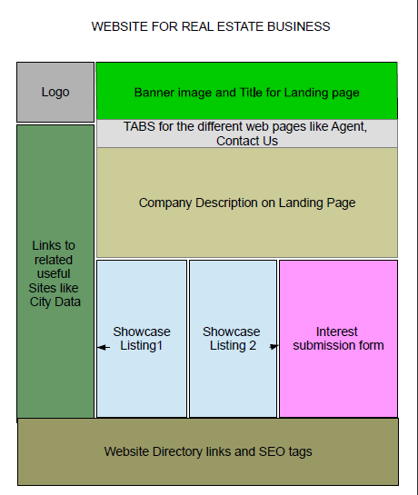
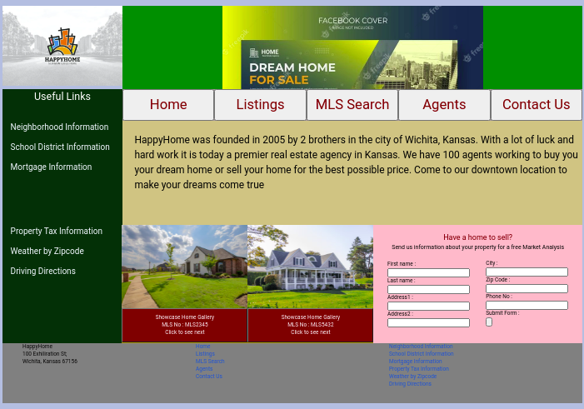

LWC-Wireframe to Web Page

Slide 4






LWC-Multiple Components
Every component
above renders
conditionally
with template directives
The navigation
button
is a component
that gets rendered
multiple times with a
different label and link
on each render
using the for:each
template directive
The input form
is a reusable
piece and hence
separated
into a component
The slides are rendered
on every mouse click
. Used render() and
Switchtemplate() to toggle

Slide 5

LWC-Response to User Input
Useful links section connects to public websites
The buttons link to other sections which for demo purposes
Are other placeholder projects in webcomponent.dev The
button on those Projects link back to Home page The button
tags were placed inside the <a> tag to achieve the combined
Effect
Clicks on the slideshow toggle between pictures

Slide 6


LWC-Styling
How
Using css for all rendering
Using flexbox containers and items
Using nested div tags

Slide 7

LWC-SDLC Methodologies
Appointed Project Manager and Scrum Master
Daily Stand Ups and Status Reports
Use of GitHub Repository
Use of Kanban Board

Slide 8
Part-II Salesforce and Security
Specifications
Continuity from Part-I
ERD,Objects and Customization
Role Hierarchy, Users Profiles and Permissions
Org level, Object level, field level and record level security
User Interface-Record Types, List views, Page layouts and
Dynamic Forms
Implementation
Lead Form and Themes and Branding for Continuity
2 Custom objects and cusomized std objects with numerous custom fields
CEO-VP-Mgr-Rep role hierarchy, several users, base profiles, permission sets by functionality, permission set groups
Company Info, Password,Object Settings in profiles, field visibility and access, OWD, roles, sharing rules
Listing and Purchase Record types with layouts and filtered list views. Hide and show field with Dynamic Forms

Slide 9
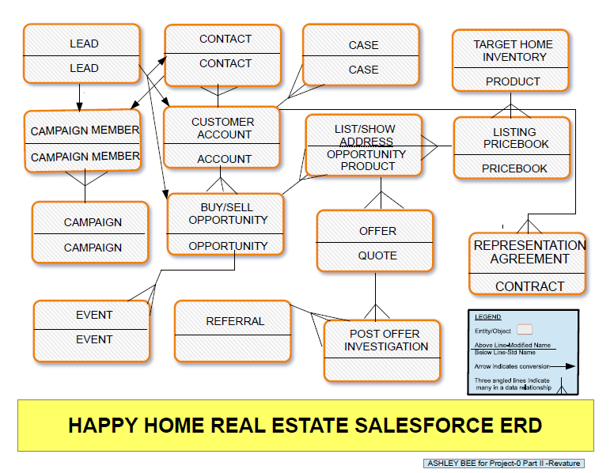

Slide 10

Salesforce: Continuity, Objects, Customization
CONTINUITY
The lead form in the Web Page connects to the
lead object in salesforce schema-contextual continuity
Branding and web page color themes continue into
Salesforce from web page
Objects and Customization
2 custom Objects -Referrals and Post Offer Investigations
extend std schema into Real Estate specific processes
Object tabs and fields renamed to familiar Real Estate speak
Customized Event and Quote Objects to fit Real Estate process
needs

Slide 11



Salesforce Security
SECURITY AT
DIFFERENT LEVELS
-Company Information, password policies
-Object Settings set by profile
- Field level security was set by profile and record type
-Record level security was set at OWD all Private, Role
hierarchy -CEO-VP-Mgr
-REP, Sharing Rules Contacts from Sales Manager and
-Subordinates to Marketing Manager and Subordinates
PROFILES, PERMISSION SETS
AND PERMISSION SET GROUPS
-Created base Profiles for Sales, Support Marketing,
CEO, Finance and HR
-Created permission sets based on functionalities
-Grouped Permission sets to create additional functionality
for the different roles

Slide 12


Salesforce: User Interface
RECORD TYPES & PAGE LAYOUTS
- Several record types but most significant is the Listing and Purchase
type Opportunity Record Types
-Custom Opportunity Process for the 2 record types
-Created custom Page Layout for each Record Type
RECORD TYPES & PAGE LAYOUTS
- Several record types but most significant is the Listing and Purchase
type Opportunity Record Types
-Custom Opportunity Process for the 2 record types
-Created custom Page Layout for each Record Type
LISTVIEWS AND DYNAMIC FORMS
-Customized List views for Buy/Sell Opportunity filtered by Record Type
-Created a dynamic form in Custom Object Post Offer Investigations
to show the vendor Referral field when status on Inspections is
Issues for a Listing type Opportunity Record Type

Slide 13
Salesforce-SDLC Methodologies
Project Manager and Scrum Master
Daily Stand Ups and Status Reports
Use of Kanban Board

Slide 14
Part-III Salesforce Automation
Specifications
Implement 2 each of workflows,
process builder, flows,approval
process and validation rules
Service tools: Case assignment and
auto-response rules and Case escalation
Marketing: Campaigns
Sales: Products and Pricebooks
Implementation
Numerous flows, process builder to call a flow and submit for approval, 2 approval processes for contracts and offers, 2 workflows -one for field calculation and another for field update and email and 2 validation rules to validate input
Case assignment and auto response on criteria and time based escalation
Send leads to campaigns before conversion and contacts after
The real estate sale happens using Product for home inventory and Pricebooks for list price

Slide 15

Salesforce
Automated Processes
2 Workflows
- Calculates Expected Agency Revenue based on Listing Agent
and Buyer Agent commissions entered based on Record Type
-Sends an email alerting that their offer is accepted
to a buyer and checking a checkbox simultaneously
2 Process Builders
-One Process Builder calls a flow to update Opportunity
to Closed Won based on criteria
-Second Process Builder automatically submits an Offer for approval
when status reaches Needs Review on an Offer of Buy Type
2 Approval Processes
. -When Status on an Offer is Needs Review,record is locked, status changes
to In Review and status changes to Approved or rejected based on
Final Action
-Second is at contract completion, a record is sent for activation if
approved and Back to Draft if rejected

Slide 16

Salesforce
Automated Processes-contd
2 FLOWS
-First Flow takes a record id for Custom Object from Process Builder and
Updates Related Opportunity Status
- Second flow: When an Event Record for an Open House is updated with
the No of Showings the dynamic button to enter attendees as leads appears.
When button is pressed the no of showings is passed to a flow
which shows the required no of forms to create the leads needed and returns
the agent back to Event Page
2 FLOWS
-First Flow takes a record id for Custom Object from Process Builder and
Updates Related Opportunity Status
- Second flow: When an Event Record for an Open House is updated with
the No of Showings the dynamic button to enter attendees as leads appears.
When button is pressed the no of showings is passed to a flow
which shows the required no of forms to create the leads needed and returns
the agent back to Event Page
2 FLOWS
-First Flow takes a record id for Custom Object from Process Builder and
Updates Related Opportunity Status
- Second flow: When an Event Record for an Open House is updated with
the No of Showings the dynamic button to enter attendees as leads appears.
When button is pressed the no of showings is passed to a flow
which shows the required no of forms to create the leads needed and returns
the agent back to Event Page
2 VALIDATION RULES
-In a Purchase Type Record Type if an agent who has no offer
accepted and synced enters commission rates they are unable to save
And told it will populate at offer acceptance
-In Custom Object Post Offer Investigations, if an agent marks commission
Check as received before marking all other statuses as approved or
completed they get an error message saying they can't.

Slide 17

Salesforce:Case Rules, Campaigns, Products, Pricebooks
CASE RULES
-Assignment: Status-New and Priority is High Case is assigned email and
owner Change to Queue
-Auto Response Rules-Status-New and Priority is High Case is recorded
email to Contact
-Case Escalation: If case not resolved in 30 minutes it is Escalated and when
escalated is checked on Case
CAMPAIGNS
Process starts with Leads that are added to campaigns as
campaign members and converted to Account, Opportunity and Contact
CAMPAIGNS
Process starts with Leads that are added to campaigns as
campaign members and converted to Account, Opportunity and Contact
PRODUCTS AND PRICEBOOKS
Products are the Home Inventory and Price books
add std Price which is the listed price of the home and so an intrinsic
part of theprocess

Slide 18
Salesforce-SDLC Methodologies
Daily Stand Ups and Status Reports
Use of GitHub Repository
Use of Kanban Board

